Slide 1
Chapter 21-22: Imitation & Shaping

Slide 2
Imitation

Slide 3
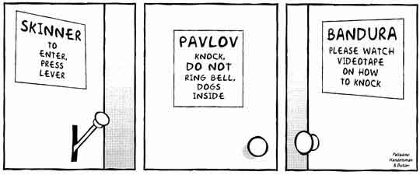

Slide 4
Bandura
Social Learning Theory
Observational Learning
Detecting another person’s behavior & its consequences
Using information to determine whether or not to imitate the behavior

Slide 5
Bandura
The individuals observed = MODELS
Modeling
Behavior change strategy in which learners acquire new skills by imitating demonstrations of the skills
Through live or symbolic models
Behavior is learned through observational learning
Engaging in the same behaviors as the model

Slide 6
Bandura vs. Skinner
Bandura (1977)
Humans are active information processors & think about the relationship between their behavior & its consequences (Mcleod, 2016)
Skinner
Individuals do not automatically observe the behavior of a model & imitate it. There is some thought prior to imitation (cognitive aspect) (Mcleod, 2016)

Slide 7
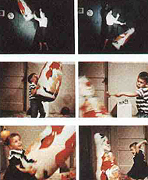
Bandura’s Research (1961; 1965)
Model
Aggressive model vs. gentle model
Consequences
Affect of consequences to models on children’s imitation:
-Punishment condition
-Reinforcement condition
-No consequence
Acquisition vs. Performance
Notes:
https://www.youtube.com/watch?v=NjTxQy_U3ac
Albert Bandura outlined the theory of observational learning. In observational learning, vicarious conditioning occurs by an organism watching another organism (a model) be conditioned. Observational learning can occur for both classical and operant conditioning.
In order for observational learning to take place, 4 key processes are at work. First the organism must pay attention to the model, retain the information observed, and be able to reproduce the behavior. Finally, an observed response is unlikely to be reproduced unless the organism is motivated to do so, i.e., they believe there will be a pay off.
Bandura distinguishes between acquisition (having the response in your repertoire) and performance (actually engaging in the behavior). Bandura asserts that reinforcement usually influences already acquired responses, more than the acquisition of new responses.
Bobo Doll Experiment
Albert Bandura believed that aggression must explain three aspects: First, how aggressive patterns of behavior are developed; second, what provokes people to behave aggressively, and third, what determines whether they are going to continue to resort to an aggressive behavior pattern on future occasions (Evans, p. 22, 1989).
In this experiment, he had children witness a model aggressively attacking a plastic clown called the Bobo doll. There children would watch a video where a model would aggressively hit a doll and " ‘...the model pummels it on the head with a mallet, hurls it down, sits on it and punches it on the nose repeatedly, kick it across the room, flings it in the air, and bombards it with balls... After the video, the children were placed in a room with attractive toys, but they could not touch them. The process of retention had occurred.
Therefore, the children became angry and frustrated. Then the children were led to another room where there were identical toys used in the Bobo video. The motivation phase was in occurrence. Bandura and many other researchers founded that 88% of the children imitated the aggressive behavior. Eight months later, 40% of the same children reproduce the violent behavior observed in the Bobo doll experiment. (Isom, 1998)

Slide 8
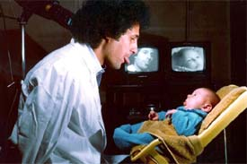
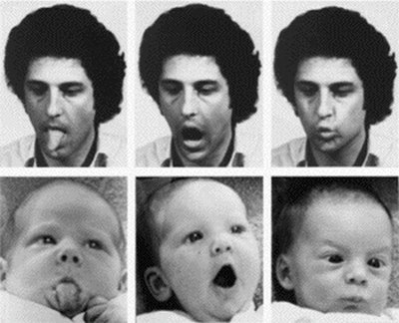
More Research on Imitation
Meltzoff & Moore (1977, 1983)
12- and 21-day old infants imitated live actions and actions that saw on television
Infants who watch a televised model on one day will reproduce the model’s behavior 24 hours later (Meltzoff, 1988)

Slide 9
Imitation Training
Imitation
Imitative behavior is occasioned by another person’s model of the behavior
Imitative behavior has formal similarity with the model
Imitative behavior follows the modeled behavior closely in time
Model is the primary controlling variable for the imitative behavior

Slide 10
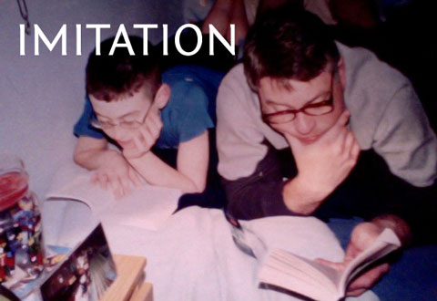
Let’s take a look…
Notes:
https://www.youtube.com/watch?v=nCSxk_zuRGA

Slide 11
Steps to Imitation Training (Striefel, 1974)
Assess and teach any prerequisite skills for imitation training
What prereqs are required?
Select models for training
Pretest
Why?
Sequence models for training
Simplest first
Perform imitation training
Notes:
Prereqs – attending, staying seated, keeping hands in lap, looking at teacher when name is called, looking at objects when prompted by teacher
Problem behaviors that may interfere with training may need to be decreased

Slide 12
Imitation Training (cont.)
Prerequisites
Attending skills
Decrease problem behaviors
Select models
Verbal imitation- echoing
Motor Imitation- moving body parts; with objects
Notes:
Demonstrate how to prompt correctly
Prereqs – attending, staying seated, keeping hands in lap, looking at teacher when name is called, looking at objects when prompted by teacher
Problem behaviors that may interfere with training may need to be decreased

Slide 13
Imitation Training (cont.)
Pretest
Training
Start with easiest
Notes:
Demonstrate how to prompt correctly
Prereqs – attending, staying seated, keeping hands in lap, looking at teacher when name is called, looking at objects when prompted by teacher
Problem behaviors that may interfere with training may need to be decreased

Slide 14
Conducting Imitation Training
Training
Begin by teaching 1 of the 3 models in your set
Start with the model most often responded to or responded to with closest similarity during pre-assessment or data collection
Intersperse the target model with a mastered response
How do you select the mastered response?

Slide 15
Conducting Imitation Training
Training
Response prompts:
Physical prompts - Use manual guidance if necessary to prompt the response
Verbal prompts - spoken or written
Gradually fade prompts as quickly as possible
Continue until learner responds correctly once –why not repeatedly?
Either end session or introduce new model

Slide 16
The Imitative Verbal Prompt
S^{D}:
S^{prompt}:
After:
Before:
Behavior:
SΔ:
Attendant doesn’t show a cat picture
After:

Slide 17
The Imitative Verbal Prompt
S^{D}:
Attendant shows a cat picture
S^{Prompt}:
Attendant says, “This is a cat.”
After:
Dicky has praise and food
Before:
Dicky has no praise or food
Behavior:
Dicky says, “Cat.”
SΔ:
Attendant doesn’t show a cat picture
After:
Dicky has no praise or food

Slide 18
Generalized Imitation
Little Timmy
I taught Timmy several imitative responses (push car, frog jumping, drinking from a cup). Then he started imitating responses when I say, “Do this,” even when those targets weren’t previously taught.
Reinforcement of previous imitative responses had generalized to these new responses – generalized imitation

Slide 19
Imitation
How do we know that Timmy has imitation in his repertoire?
Evoked by a novel (aka NEW) model
Response looks the same as model
Powerful way to learn!!
Language
Social/Daily Living
Play
Notes:
What do we do if he does not have imitation in his repertoire?

Slide 20
Summary
Imitation is the most efficient way to acquire new behavior
Teaching imitation requires less effort from the teacher or student as opposed to shaping and chaining
Model what you want your students to imitate
Differentially reinforce imitation to decrease the probability of students imitating models of inappropriate behavior

Slide 21
Shaping

Slide 22
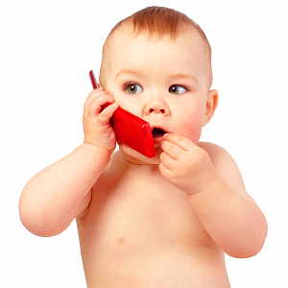
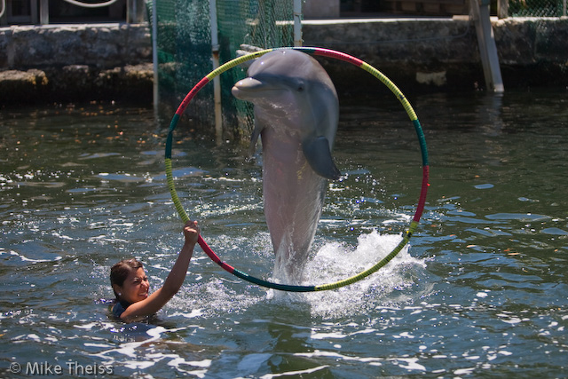
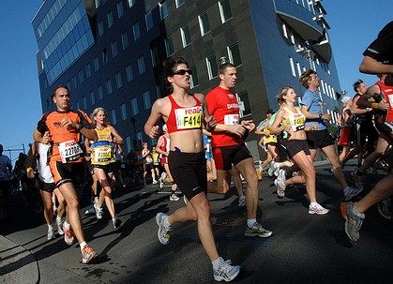
How do you increase a behavior using reinforcement when it does not occur by chance?

Slide 23
Shaping:
Differential reinforcement of successive approximations to a target behavior
Reinforcement
Initial
Bx
Goal
Bx

Slide 24
Shaping:
Differential reinforcement of successive approximations to a target behavior
Reinforcement
Initial
Bx
Goal
Bx

Slide 25
Shaping:
Differential reinforcement of successive approximations to a target behavior
Reinforcement
Initial
Bx
Goal
Bx

Slide 26
Shaping:
Differential reinforcement of successive approximations to a target behavior
Reinforcement
Initial
Bx
Goal
Bx

Slide 27
Shaping:
Differential reinforcement of successive approximations to a target behavior
Reinforcement
Initial
Bx
Goal
Bx

Slide 28
How does it work?
Differential reinforcement: Selective reinforcement of a particular response
Extinction: Cessation of reinforcement for a previously reinforced response
Extinction-induced variability: variability in behavior (e.g., increase in frequency, force, novel behavior) as a function of extinction burst

Slide 29
Response Differentiation
Involves two components:
Differentially reinforce behaviors that resemble the terminal behavior
Carefully changing the criterion for reinforcement
Result
Increase in behaviors successively closer to terminal behavior
Decrease in behaviors that are not successively closer to terminal behavior

Slide 30
Steps involved in Shaping
Define the final target (goal) response
Is shaping needed?
Identify the starting target response
What is the subject already doing?
Define the shaping steps towards the final target response
Begin differentially reinforcing successive approximations
Failure? Check: reinforcer, step size, pace

Slide 31
Pryor’s Laws of Shaping (abridged version)
Raise criteria in increments small enough that the subject always has a realistic chance for reinforcement.
Train one aspect of any particular behavior at a time
Stay ahead of your subject
If behavior deteriorates, “go back to kindergarten”
End each session on a high note, if possible

Slide 32
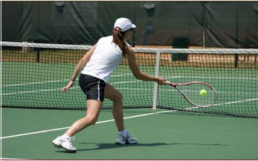
An example: Lisa’s tennis lesson

Slide 33
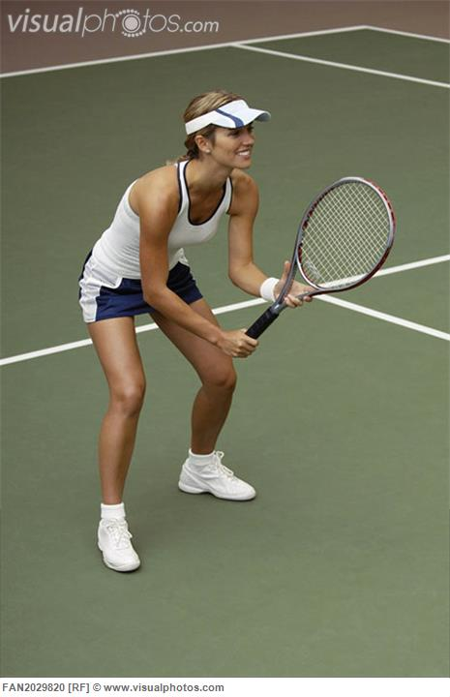
An example: Lisa’s tennis lesson

Slide 34
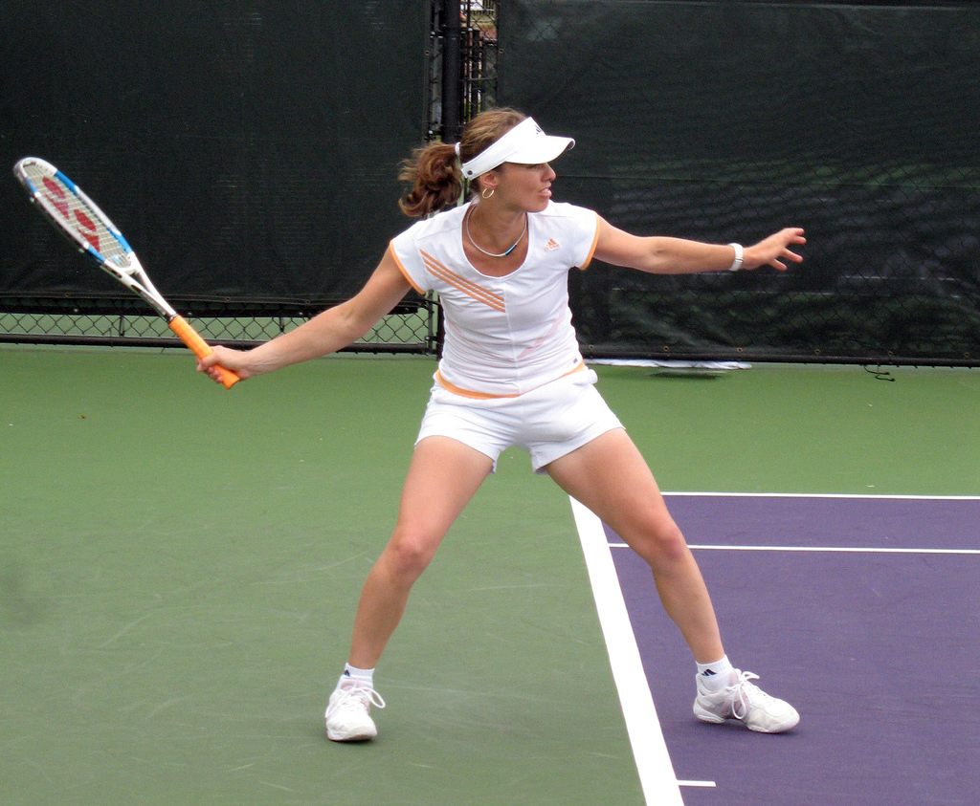
An example: Lisa’s tennis lesson

Slide 35
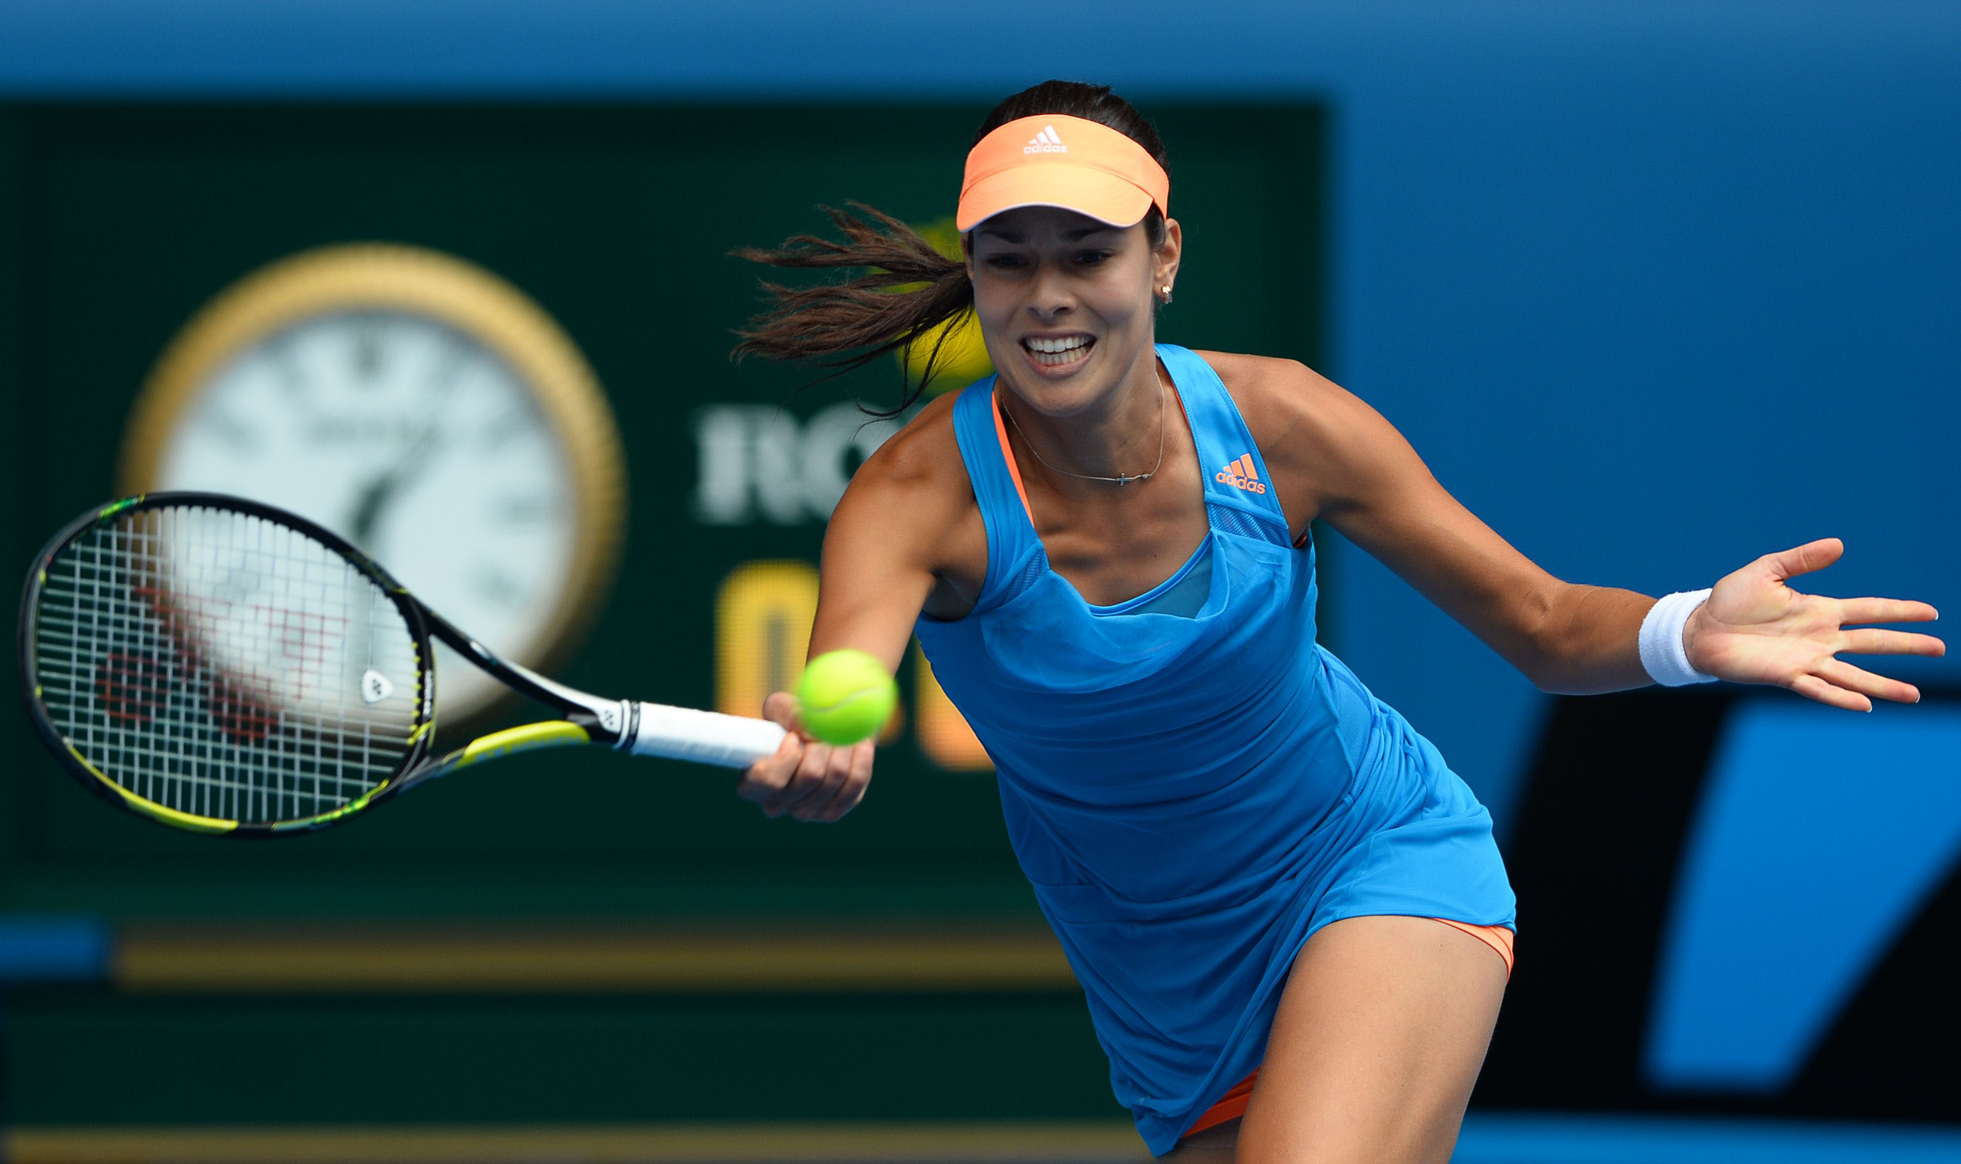
An example: Lisa’s tennis lesson

Slide 36

An example: Lisa’s tennis lesson

Slide 37
Inadvertent Shaping
AKA: Shaping a problem behavior without intending to:
Initially, child sobs when it’s clean up time
Child cries when it’s clean up time
Child screams when it’s clean up time
Child screams, hits, and throws when it’s clean up time

